Slide 1






PRESENTATION 2026
Student Name
Student Email
Priyanka tambe
priyankatambe568@gmail.com
Mentor Name
Guide Name
Uma maheswari

Slide 2

Outline
Abstract of the Project
Problem Statement
Proposed Solution
System Architecture
Live Demo of the Project
Embedded Video of Project
Conclusion
Future Scope

Slide 3
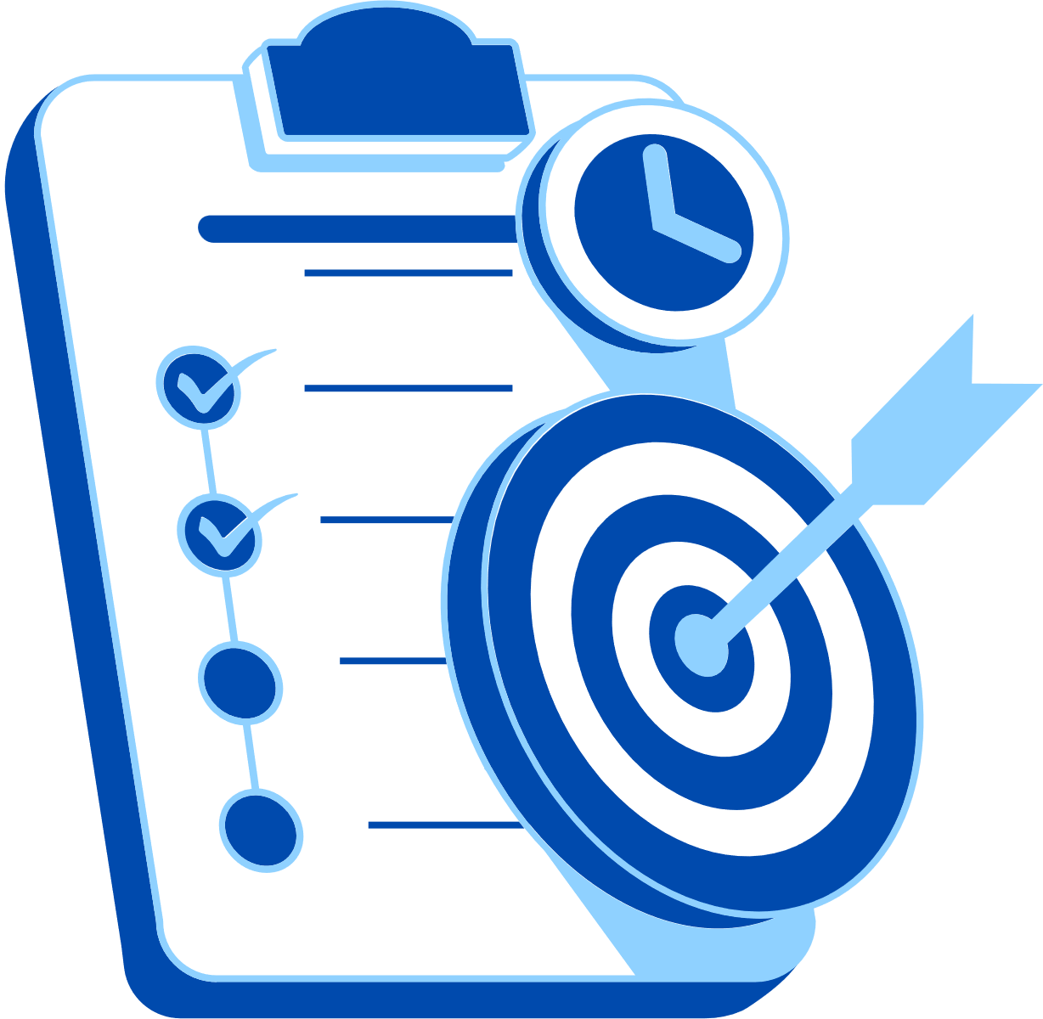
Abstract
This project aims to improve the quality of hospital patient data by cleaning and organizing records, and then presenting them through a health metric dashboard. The main objective is to remove errors, duplicates, and missing values so that accurate analysis can be done. Tools like Power BI and Microsoft Excel are used for data cleaning and visualization. The expected outcome is a clear and interactive dashboard showing important metrics such as patient count and disease trends. A key highlight of this project is transforming raw, messy data into meaningful insights for better healthcare decisions.

Slide 4

Problem Statement
Hospitals often have patient records with errors, duplicates, and missing data, making analysis difficult. This is a major issue because inaccurate data affects decision-making and patient care. Doctors, hospital staff, and management are directly affected. Existing tools like Microsoft Excel are used, but without proper cleaning methods, they cannot ensure data accuracy. This project focuses only on cleaning patient records and creating a dashboard for basic health metrics, not on full hospital system management.

Slide 5

Proposed Solution
The solution is to clean hospital patient data and create a dashboard for easy analysis. The process includes removing duplicates, handling missing values, and organizing the data in a proper format. Tools like Microsoft Excel and Power BI are used for data cleaning and visualization. After cleaning, a dashboard is created to show key health metrics like patient count and disease trends. This approach improves data accuracy, saves time, and helps hospital staff make better decisions

Slide 6
System Architecture
Data Input / Source
Processing / Analysis
Patient data is collected from hospital records such as Excel files, databases, or CSV files.
Data is cleaned by removing duplicates, fixing errors, and handling missing values using Microsoft Excel.
AI / Tool Integration
Output / Dashboard
Tools like Power BI and Excel are used to analyze data and create visual reports.
The final output is an interactive dashboard showing charts like patient count, disease trends, and reports for easy understanding.

Slide 7
Live Demo of Project
Here's the list of some demo screenshots / features of the project:
Demo 1
Demo 2
Demo 3
Shows raw patient data with errors like duplicates and missing values, and how data cleaning is performed using Microsoft Excel.
Displays the processed and cleaned data, organized in a proper format ready for analysis.
Presents the final dashboard created in Power BI showing charts like patient count and disease trends.

Slide 8
Video of Project Demo
[https://your-project-demo-link.com]
▶
[Insert your project demo video.
You can embed a video your live project.]

Slide 9

Conclusion
This project successfully cleaned hospital patient data and created a health metric dashboard for better analysis. The main objective of improving data accuracy and visualization was achieved. The results help hospital staff understand patient trends easily and make better decisions. Overall, the project adds value by making healthcare data more reliable and useful.
CONCLUSION

Slide 10
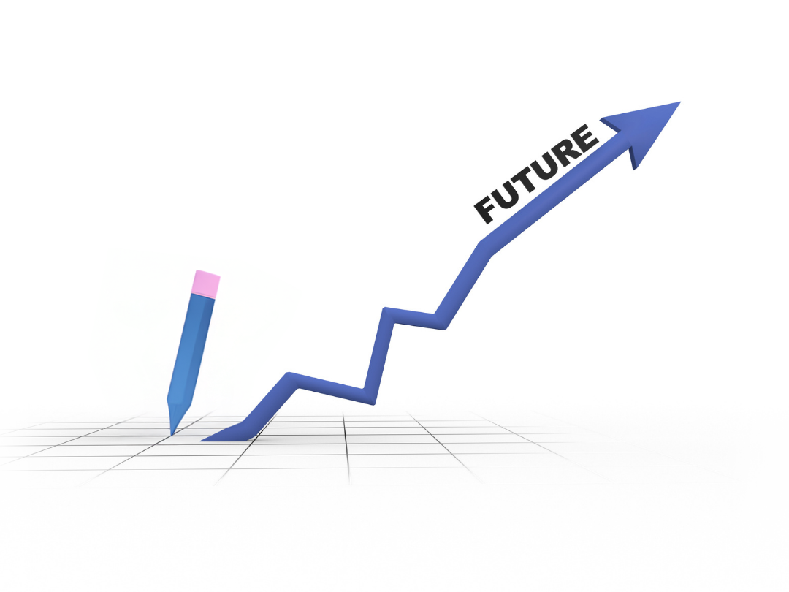
Future Scope
In the future, this project can be improved by adding real-time data integration and connecting with hospital systems. Advanced features like AI-based prediction and automation can be included. The dashboard can also be made mobile-friendly and cloud-based for better accessibility and scalability.

Slide 11
Thank You
AICW Fellowship | Student Project Presentation 2026
LinkedIn | Edunet Foundation

